Slide 1
Living on the Edge: (Re)focus DNS Efforts on the End-Points
Benno Overeinder NLnet Labs
RIPE 75, Dubai, UAE

Slide 2
Complexity at Core-Middle-Edge
moderate
Authoritative .
simple
complex
recursive resolver
application
ripe75.ripe.net
stub
Authoritative net
193.0.19.34
OS
Authoritative ripe
e2e-ness complex
e2e-ness moderate
e2e-ness simple

Slide 3
From the ground-up security
… and now for something completely different

Slide 4
Customer–Web Portal Interaction
auth name servers
com.
acme.
portal.
full recursive resolver
customer
portal.acme.com
host
IP address
browser
web portal
http/https
http server
IP address

Slide 5
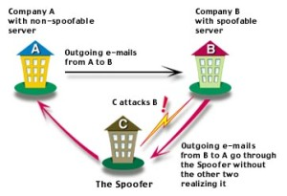
DNS Spoofing
DNS Spoofing by cache poisoning
attacker flood a DNS resolver with phony information with bogus DNS results
by the law of large numbers, these attacks get a match and plant a bogus result into the cache
Man-in-the-middle attacks
redirect to wrong Internet sites
email to non-authorized email server
Notes:
What risks?
Misdirection of queries for an entire domain
Response to non-existent domains
MX hijacking
Make a large domain (SLD or TLD) domain “disappear” from an ISP's cache – DoS
Identity theft using SSL stripping attacks (banks, eGovernance)
More fun stuff…
A great illustrated guide
http://unixwiz.net/techtips/iguide-kaminsky-dns-vuln.html

Slide 6
The “Too Many CAs” Problem
TLS clients have abundance of TAs
modern web browsers have 1300+ TAs
any of them can issue certificate for example.com
TLS client accepts both!
credits wes.hardaker@parsons.com
Notes:
Most notable incidents are with Comodo RA (2011) and DigiNotar (2011).

Slide 7
Customer–Web Portal Interaction
auth name servers
com.
acme.
portal.
full recursive resolver
DNS spoofing
customer
portal.acme.com
host
IP address
browser
web portal
too many CAs
http/https
http server
CA pinning/HSTS?
IP address

Slide 8
DNSSEC-Based Secure Customer–Web Portal Interaction
auth name servers
DNSSEC
com.
acme.
portal.
full recursive resolver
DNS spoofing
customer
portal.acme.com
host
IP address
browser
web portal
DANE
too many CAs
http/https
http server
IP address

Slide 9

Resolver Hijack?!
ARP, DHCP or routing tricks
auth name servers
DNSSEC
com.
acme.
portal.
portal.acme.com
full recursive resolver
6.6.6.1
DNS spoofing
host
browser
web portal
DANE
too many CAs
http server
IP address
http/https

Slide 10
Countering Resolver Hijack
DNSSEC on the stub
DNS-over-TLS

Slide 11

Countering Resolver Hijack (cont’d)
DNS-over-TLS
DNS-over-TLS
TLS hijack of DNS-over-TLS
Bootstrap the TLSA lookup with regular DNS?
Chicken and egg problem.

Slide 12
DNSSEC Data Blob-over-TLS
TLSA record + the complete DNSSEC authentication chain embedded in a TLS extension
TLS DNSSEC authentication to prevent “Too many CA’s” problem
https://tools.ietf.org/html/draft-ietf-tls-dnssec-chain-extension

Slide 13
DNS Privacy and Standards
DNS privacy requirements
Capability | Standard
DNS-over-TLS | RFC7858
Reuse/pipelining/OOOP | RFC7766
TCP fast open | RFC7413
ENDS0 keep alive | RFC7828
ENDS0 padding | RFC7830
PKIX support for authentication | (various)
DNSSEC support (for address lookup and authentication) | (various)

Slide 14
DNSSEC Roadblocks
Consequences of living on the edge

Slide 15
DNSSEC Roadblocks
Resolving DNSSEC (to cross the first mile) needs DNSSEC aware recursive resolver

Slide 16
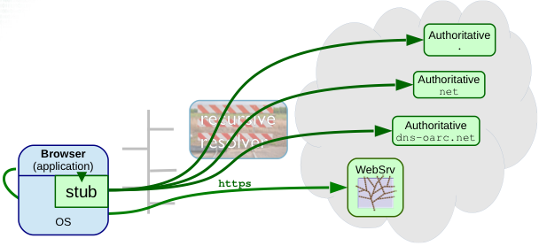
DNSSEC Roadblock Avoidance
DNSSEC roadblock avoidance + full recursion capability
https://tools.ietf.org/html/rfc8027

Slide 17
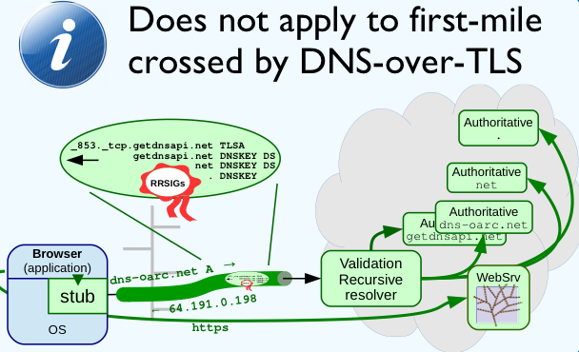
DNSSEC Roadblock Avoidance
DNSSEC roadblock avoidance + full recursion capability
https://tools.ietf.org/html/rfc8027
DNSSEC authentication chain extension

Slide 18
DNSSEC with DNS64 & NAT64
Jen Linkova’s “Let’s talk about IPv6 DNS64 & DNSSEC”
https://blog.apnic.net/2016/06/09/lets-talk-ipv6-dns64-dnssec/
With IPv6 prefix discovery, stub can do DNSSEC validation of A RR itself

Slide 19
DNSSEC with DNS64 & NAT64
IPv6 address synthesis prefix discovery + DNS64 capability
https://tools.ietf.org/html/rfc7050
https://tools.ietf.org/html/rfc6147

Slide 20
KSK Root Rollover
More roadblocks ahead

Slide 21
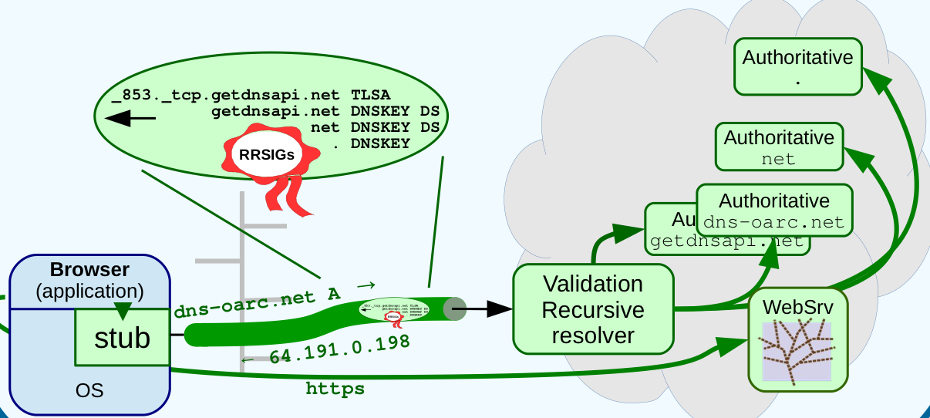
RFC5011 for DNSSEC Validating Stubs
DNSSEC validating stub must do RFC5011
In-band RFC5011 tracking with DNSSEC auth chain TLS extension

Slide 22
KSK Root Rollover for Stub Library
A stub library for DANE
runs with user’s privileges
no system config
bootstrap DNSSEC capabilities
https://tools.ietf.org/html/rfc7958
unbound-anchor functionality

Slide 23
DNSSEC Roadblocks and Standards
DNSSEC stubs capability requirements
Capability | Standard
DNSSEC validation | (various)
DNSSEC roadblock avoidance | RFC8027
IPv6 prefix discovery | RFC7050
IPv6 address synthesis | RFC6147
Automated trust anchor updates | RFC5011
Automated initial trust anchor retrieval | RFC7958

Slide 24
Living on the Edge
“Final Thoughts”

Slide 25
Wrapping Up
Stub resolver/library experience complex e2e-ness
at the edge of the network many kinds of roadblocks/brokenness
DNS-based security from the ground up
bootstraps with the stub
Closing the gap in the last mile with ongoing work
overview of RFCs and drafts
most of discussed work is implemented in getdns and its stub resolver Stubby
DNSSEC Authentication Chain Extension
https://tools.ietf.org/html/draft-ietf-tls-dnssec-chain-extension

